Slide 1



Planning TODAY for Tomorrow
Your Guide to a WORRY-FREE RETIREMENT
By
Dotun Olaleye
1st June 2025

Slide 2

OBJECTIVES
AND OUTLINE
What is the topic and what are the aims/objectives this presentation
Importance of planning for retirement
Retirement standards
Planning – What does this mean?
Life expectancy for male and female post retirement
Timing – when is the right time and am I too late?
Key things to consider about planning for retirement
Sources of income in retirement (Investment vehicles towards it)
Employed and Self Employed
How do ensure I plan to ensure I don’t run of money after retirement?
Question and Answers

Slide 3
WHAT IS THE TOPIC AND WHAT ARE THE AIMS/OBJECTIVES OF THIS PRESENTATION
There are 5 main objectives which I hope we will achieve during this presentation:
01
02
03
04
05
To merely shine a
light on the area of planning for our old age and to draw out the disparity in society due to knowledge and information.
To ultimately
challenge us to seek professional advice from a qualified Financial Advisor, or for those who are financially savvy, to put together a plan for their families.
To ensure my friends and family are aware
of the potential risks
of not adequately planning for
retirement
To identify some
of the problems and challenges facing individuals and reasons why folks
fail to plan
To create an avenue
to have a robust discussion about these points, share personal knowledge and experiences
Gift of God to us all
“Knowledge”

Slide 4


WHAT IS THE TOPIC AND WHAT ARE THE AIMS/OBJECTIVES OF THIS PRESENTATION
WHAT IS THE PROBLEM?
Research shows we are inadequately prepared for a comfortable standard of living in retirement.
More than one in four (26 percent) think that income of as little as £11,500 a year will be enough to sustain the lifestyle they want.
According to Retirement Living Standards published by the Pension and Lifetime Savings Association in October 2019, this is a shocking £22,000 less than the recommended comfortable Retirement Standard of Living amount.
The Retirement Living Standards said that a comfortable lifestyle for a single person is estimated to require an income of £31,300 - although this may be higher if a person lives in London or the South East (£32,800).

Slide 5

WHAT IS THE TOPIC AND WHAT ARE THE AIMS/OBJECTIVES OF THIS PRESENTATION
BARRIERS TO ACHIEVING ADEQUATE RETIREMENT INCOME
Not engaging early enough: Conflicting priorities, comfort of cash, and unrealistic expectations
Complexity of the system: Moving goal posts erode engagement
The lack of consistent tax rules to support long-term planning
The advice and capability gaps: enhancing individuals’ understanding on how much
to save
Low level of contribution rates in workplace pensions

Slide 6


IMPORTANCE OF PLANNING FOR RETIREMENT
The Average Life Expectancy Continues To Rise
You Can’t Work Forever
Retirement Is The Best Time to Check Off Your Bucket List
Relying On state pension alone Is Risky (That’s even if you qualify)
Your Retirement Can Contribute to Your Family
It’s Unfair To Depend Upon Your Family
You Always Have Enough Money To Save For Retirement

Slide 7

RETIREMENT STANDARDS
A new set of "retirement living standards" has revealed how much money savers will need to have a "comfortable" retirement.
The guidance, set out by the Pensions and Lifetime Savings Association, also shows what kind of lifestyle a person can expect on a minimum or moderate retirement income.
The trade association has said it hopes the standards resonate in the same way being told to eat "five a day" has encouraged fruit and vegetable consumption.
RETIREMENT LIVING STANDARDS
 |  | One person | Per couple
UK | Comfortable | £ 43,100 | £ 59,000
 | Moderate | £ 31,300 | £ 43,100
 | Minimum | £ 14,400 | £ 22,400
London/ South East | Comfortable | £ 45,000 | £ 61,200
 | Moderate | £ 32,800 | £ 44,900
 | Minimum | £ 15,700 | £ 24,500
Published in a report by Pensions and Lifetime Savings Association (PLSA) and Loughborough University

Slide 8


PLANNING – WHAT DOES THIS MEAN?
There are two components to retirement income planning: Personal Planning and Financial Planning.
  Personal planning is important because it is the determining factor of your satisfaction with your retirement lifestyle.
  Financial planning is crucial because it identifies your sources of income and expenses and establishes your retirement budget, based on your personal plan.

Slide 9
Personal Planning
All too often people entering retirement do not place enough emphasis on personal planning to ensure they maximise their opportunities. So take the time now -- at an early stage in your planning process -- to think about the choices you have about how you would like to spend your time during retirement.
    Do you want to volunteer at a local hospital?
    Take up that hobby you were always interested in, but never had the time
    to start?
    Go back to school and pick up a few special interest courses?
    Start your own business? Travel around the world?
    Buy property in a warmer climate and spend the winter months there?
These, and many other lifestyle questions based on your preferences, are all important factors to consider when planning your retirement since your choices will drive the financial circumstances that must be meet in order to achieve your goals.
PLANNING – WHAT DOES THIS MEAN?

Slide 10
Financial Planning
Will you have adequate funds to provide the kind of retirement lifestyle you envision? Remember your income will likely come from three general sources:
    Government pensions,
    Employment-related sources and
    Your own personal investments.
Your retirement will be more enjoyable if your income is structured to fit your lifestyle choices and if you have developed a retirement plan to protect the assets you have worked hard to acquire.
PLANNING – WHAT DOES THIS MEAN?

Slide 11


LIFE EXPECTANCY FOR MALE AND FEMALE POST RETIREMENT
Health and longevity
People are living longer than they used to. A 65 year old man now has a 50% chance of living to 87 and a 65 year old woman has a 50% chance of living to 90.
Many people underestimate how long they’re going to live. This is not a problem if you have a guaranteed income for life. But if you don’t, you need to make sure you don’t run out of money so that you have enough to live on for the whole of your retirement. At the same time, you don’t want to live more frugally than you actually need to because you’re worrying too much about running out of money.
Your health may become an issue as you get older. So you may want to set aside some money or have a rising income so that if your health does deteriorate you can afford to pay for extra help around the home or for care fees
A 65 year old WOMAN has
A 65 year old MAN has
75% chance of living to 82
75% chance of living to 79
50% chance of living to 90
50% chance of living to 87
25% chance of living to 96
25% chance of living to 94
14% chance of living to 100
9% chance of living to 100

Slide 12


TIMING – WHEN IS THE RIGHT TIME AND AM I TOO LATE?
WHEN SHOULD YOU START PLANNING FOR RETIREMENT?
The answer is simple: as soon as you can. Ideally, you'd start saving in your 20s, when you first leave school and begin earning a salary. That's because the sooner you begin saving, the more time your money has to grow.
Each year's gains can generate their own gains the next year - a powerful wealth-building phenomenon known as compounding.
IS IT TOO LATE FOR ME TO START NOW?
Is 45 too late to start saving for retirement?
The good news, though, is that it's never too late to start saving. Even if you're in your 40s or 50s and don't have a penny in your retirement fund, you can still save hundreds of thousands of pounds if you're strategic about saving
Is it too late to save for retirement at 55?
There's still time to give your savings a good boost before you retire. If you're between 55 and 64 years old, you still have time to boost your retirement savings. ... It's never too early to start saving, of course, but the last decade or so before you reach retirement age can be especially crucial.
Independent Financial Adviser (IFA) and pensions specialist Adam Reeves, says “No matter how old you are it is never too late to think about financially planning for your retirement and paying into an investment scheme.

Slide 13

KEY THINGS TO CONSIDER ABOUT PLANNING FOR RETIREMENT
Key questions to ask yourself before you start planning?
When do I wish to retire?
Where do I want to retire?
How much do I need when I retire? – based on the standard of life you want when you retire
Get professional advice to help you draw up a plan to achieve this (or you can do it yourself)
https://www.moneyadviceservice.org.uk/en/articles/personal-pensions
https://www.pensionsadvisoryservice.org.uk/
https://www.gov.uk/plan-retirement-income/get-financial-advice

Slide 14

SOURCES OF INCOME IN RETIREMENT (INVESTMENT VEHICLES TOWARDS IT)
UNDERSTAND HOW YOUR SOURCES OF INCOME FIT TOGETHER
Salary related pension
State pension
Savings and investment
Paid work
State benefits
Other income
Pension
pot
Property
Secure
Non-secure

Slide 15
SOURCES OF INCOME IN RETIREMENT (INVESTMENT VEHICLES TOWARDS IT)
PAID WORK
Retirement is no longer the cliff-edge it once was. Many people choose to work longer or retire gradually which means they don't have to rely on just their pension income.
If you carry on working you may continue contributing to your pension so that you have a bigger pot when you eventually give up work altogether.
Bear in mind that you may have to stop working sooner than you would like if you develop health issues.

Slide 16

SOURCES OF INCOME IN RETIREMENT
(INVESTMENT VEHICLES TOWARDS IT)
STATE PENSION
You'll usually need at least 10 qualifying years on your National Insurance record to get any State Pension. You'll need 35 qualifying years to get the full new State Pension. You'll get a proportion of the new State Pension if you have between 10 and 35 qualifying years.
Most people qualify for at least some State Pension when they reach their State Pension age. This provides you with a secure income for life which increases by at least the rate of inflation each year.
If you’re still working or have enough income from other sources once you reach your State Pension age, you may decide to defer taking your State Pension so that you receive a higher income from it later on.
You may be able to make extra payments to maximise your State Pension if you don’t yet qualify for the full amount.
When you die your State Pension stops but your spouse or civil partner may be able to boost their own State Pension based on your contributions. This only applies to people who reached State Pension age before 6 April 2016
NI Credit - https://www.gov.uk/national-insurance-credits/eligibility
https://www.gov.uk/check-national-insurance-record

Slide 17
SOURCES OF INCOME IN RETIREMENT (INVESTMENT VEHICLES TOWARDS IT)
SALARY-RELATED PENSIONS FROM EMPLOYERS (FOR CONTRACTORS – SELF INVESTED PERSONAL PENSION)
If you are a member of a defined benefit scheme (also known as an employer’s salary-related pension scheme such as a final salary or career average scheme) you will receive a pension from these based on how long you worked for the organisation and how much you earned.
This pension is a secure income for life, it usually increases over time and often provides an income for your dependants if you die before them. You can usually take up to 25% of your pension entitlement as a tax-free lump sum at the outset, but the more cash you take the lower the income you will get.
You cannot take all of your salary-related pension as a cash lump sum. If you want to do this you will have to transfer out of your salary-related pension scheme into a personal pension (if you’re allowed to) and this is not usually a good idea. If your pension is worth £30,000 or more you will have to take advice from a regulated financial adviser before you can transfer.

Slide 18
SOURCES OF INCOME IN RETIREMENT (INVESTMENT VEHICLES TOWARDS IT)
SAVINGS AND INVESTMENTS
You may have savings or investments which will provide you with some income in retirement. This income is likely to be variable and there’s no guarantee it will rise over time.
The amount of interest you earn on your savings will depend on interest rates which change over time. If you have stock market investments, the income from these may change depending on the types of investments you choose and how well they perform.
If you take more than the income or growth on your savings or investments, this will reduce the amount of income they earn. You will also have less savings left for the future.
The income you get from your savings and investments is usually taxable unless they are in a tax-efficient savings scheme such as an ISA.
Any savings or investments you have when you die can be passed on to your heirs.
It’s worth noting that all your savings and investments (even if they’re in an ISA) may be added to your estate when it’s assessed for Inheritance Tax.

Slide 19
SOURCES OF INCOME IN RETIREMENT (INVESTMENT VEHICLES TOWARDS IT)
PROPERTY
You may have property which provides you with some income. This could be your own home (you may have a lodger) or rental property you own.
You may plan to sell or release some equity from your property to provide you with extra income or to pay for care in later life.
If you decide to sell your own home and downsize you need to take into account any costs involved as this can significantly reduce the amount of cash you raise to provide yourself with extra income.
If you sell any other property you may have to pay Capital Gains Tax on any increase in value you make.

Slide 20
SOURCES OF INCOME IN RETIREMENT (INVESTMENT VEHICLES TOWARDS IT)
STATE BENEFITS
You may be entitled to certain state benefits, like Pension Credit. Nearly all benefits are means-tested and so may be affected by how much income or capital you have, so you need to bear this in mind when deciding what to do with your pension pot.
OTHER INCOME
This could include income you receive from a trust, a survivor’s pension, inherited income such as from a deceased spouse’s pension, gifts from family or friends.
Some of this may be secure income which increases over time and is paid for life. Other income may be ad-hoc or not guaranteed so you will not be able to rely on it.

Slide 21

EMPLOYED AND SELF EMPLOYED
Saving into a pension is one of the most sensible financial steps you can take. Not only are you putting something aside to have a comfortable life in the future, but you're also getting free money from the government and your employer for doing so.
Tax relief
Compound interest
Employer contributions
Guaranteed income at the end
It’s a no brainer – you are doing yourself a disadvantage by not joining your workplace pension scheme
– Dotun Olaleye

Slide 22

EMPLOYED AND SELF EMPLOYED
If you’re self-employed, saving into a pension can be a more difficult habit to develop than it is for people in employment. There is no-one to choose a pension scheme for you, no employer contributions and irregular income patterns which can all make saving difficult. But preparing for retirement is crucial for you too
There are around
4.8 million self-employed people in the UK accounting for 15% of the UK workforce. Yet just 31% of the self -employed are saving into a pension.
If you’re self-employed you’re entitled to the State Pension in the same way as anyone else.

Slide 23

EMPLOYED AND SELF EMPLOYED
The earlier you start saving into a pension, the better.
It gives you more time to contribute to your savings before retirement, more time to benefit from tax relief, and more time for your savings to grow.
Starting early could more than double your pension pot:
*Assuming savings grew at 5% a year and charges were 0.75% a year
You pay | Government pays | Start saving at age | Pension pot at 65
£100 | £25 | 30 | £70,000
£100 | £25 | 40 | £46,000
£100 | £25 | 50 | £25,000*

Slide 24

Self-employed: what kind of pension should I use?
Most self-employed people use a personal pension for their pension savings.
With a personal pension you choose where you want your contributions to be invested from a range of funds offered by the provider.
The provider will claim tax relief at the basic rate of tax on your behalf and add it to your pension savings.
How much you get back depends on how much is paid in, how well your savings perform, and the level of charges you pay.
EMPLOYED AND SELF EMPLOYED
There are 3 types of personal pension:
Ordinary personal pensions
Stakeholder pensions
Self-invested personal pensions
Which are offered by most large providers
Where the maximum charge is capped at 1.5% and you can stop and start premiums without penalty
Which have a wider range of investment options, but usually higher charges.

Slide 25

HOW DO ENSURE I PLAN TO ENSURE I DON’T RUN OF MONEY AFTER RETIREMENT?
We all know the formula E=MC2, but few of us can explain Einstein’s General Theory of Relativity.
You’ll be pleased to know that you don’t need to be Einstein to work out how much you can take out of your retirement savings.
The 4% Rule
30 years of research into retirement funding has somehow been condensed into the “4% Rule”.
According to this ‘rule’, you take your pension fund, and multiply it by 4%, to work out how much you can withdraw from your savings in year one.
Then you increase that figure every year by inflation.
And, according to the rule, there’s no chance that you will run out of money during your retirement.
So, if you have a pension fund of £500,000, you can withdraw £20,000 in year one, and increase that amount by inflation every year, and you’ll never run out of money.
This sounds straightforward, and could be applied to all sorts of retirement savings, making it easy for people to work out how much income they can enjoy, and whether alternatives, like annuities are attractive.

Slide 26

EXAMPLES
Your estimated total pension fund at retirement age:
Your estimated total pension fund at retirement age:
Your estimated total pension fund at retirement age:
£481,618*
£321,078.67*
£160,539.33*
Assuming you are 40 years old and plan to retire at age 68. With a monthly savings of £900 per month @ a fund performance of 6%, inflation @ 2% and Charges at 0.75% per annum:
Assuming you are 40 years old and plan to retire at age 68. With a monthly savings of £600 per month @ a fund performance of 6%, inflation @ 2% and Charges at 0.75% per annum:
Assuming you are 40 years old and plan to retire at age 68. With a monthly savings of £300 per month @ a fund performance of 6%, inflation @ 2% and Charges at 0.75% per annum:
Retirement income options:
Retirement income options:
Retirement income options:
Drawdown:
Drawdown:
Drawdown:
Annuity:
Annuity:
Annuity:
Yearly income in advance, based on 6% investment growth over 20 years:
Yearly income in advance, based on 6% investment growth over 20 years:
Yearly income in advance, based on 6% investment growth over 20 years:
Yearly non-guaranteed annuity that increases with RPI:
Yearly non-guaranteed annuity that increases with RPI:
Yearly non-guaranteed annuity that increases with RPI:
£39,612.88
£26,408.59
£13,204.29
£18,783.1
£12,522.07
£6,261.03
* This figure is based on the following assumptions:
* This figure is based on the following assumptions:
* This figure is based on the following assumptions:
Fund performance
Fund performance
Fund performance
Inflation
Inflation
Inflation
Charges
Charges
Charges
6%
6%
6%
2%
2%
2%
0.75%
0.75%
0.75%
Fluctuations in fund performance can happen – we give examples below of how lower fund performance will impact the size of your pension pot.
Fluctuations in fund performance can happen – we give examples below of how lower fund performance will impact the size of your pension pot.
Fluctuations in fund performance can happen – we give examples below of how lower fund performance will impact the size of your pension pot.
Estimated total pension fund at retirement
Estimated total pension fund at retirement
Estimated total pension fund at retirement
Fund performance
Fund performance
Fund performance
£350,463.27
£233,642.18
£116,821.09
4%
4%
4%
£259,469.39
£172,979.59
£86,489.8
2%
2%
2%

Slide 27
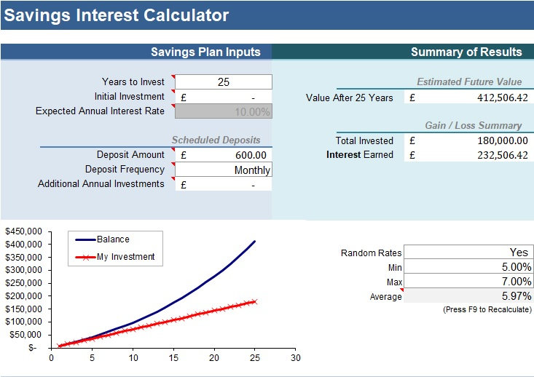

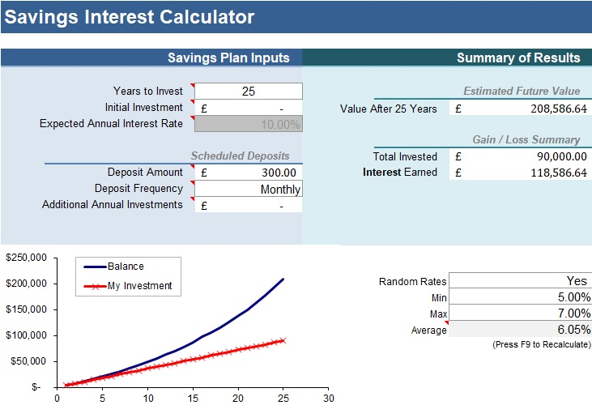
EXAMPLES
Having ISA savings over a long period of time will enable families to have tax free investment which can be passed to the next generation: see samples below:

Slide 28

CONCLUSION
There is a need for all of us to take the necessary steps to ensure we are not left in limbo @ retirement.
Draw up a plan that looks at various and possible income streams when you retire i.e.
Its never too late to start
Check you are on track to qualify for State Pension
Save for retirement
Seek professional advice
Annually £50,000 - Example
6,400
15,600
18,000
10,000
ISA or Investment Savings
Rental income-Property
Personal or work Pension
State Pension

Slide 29

QUESTION AND ANSWERS

