Slide 1
FINANCIAL MASTERCLASS Empowering You to Take Control of Your Finances
Sunday, 1st June 2025
Dotun Olaleye

Slide 2
Introduction and Plan for the evening
Our focus for today
1
2
3
How to pay of mortgage early?
Creating a budget that actual works
Top tips for savings and investment
☺ We may touch on other areas depending on time, but above is our focus!

Slide 3
How realistic is being Mortgage Free?
"The average UK mortgage holder paid approximately £17,676 last year in repayments," according to recent statistics. "Clearing your mortgage can significantly boost your disposable income, offering greater financial flexibility and peace of mind," notes Angela Kerr from the HomeOwners Alliance.
The great news is that paying off your mortgage early is a realistic goal with proper planning and effort. As Daniel Hegarty, CEO of online mortgage broker Habito, explains: "Becoming mortgage-free remains a dream for millions across the UK, and with the right approach, it’s more achievable than you might think."

Slide 4
What is Mortgage Overpayment?
Mortgage overpayment involves paying more than your regular monthly mortgage payment.
1
Regular: Adding extra to your monthly payments.
2
One-off: Making a lump sum payment.
Check your lender’s overpayment policies, as some may charge penalties for early repayment.

Slide 5
Pros and Cons of Mortgage Overpayment
Reduces the total interest paid over the loan term.
May reduce liquidity.
Shortens the mortgage term, freeing you from debt sooner.
Opportunity cost: Could the money be better invested elsewhere?
Pros
Cons
Builds equity faster.
Early repayment charges (if applicable).

Slide 6
Tackling Other High-Interest Liabilities First
Prioritise paying off high-interest debts like credit cards or personal loans before making mortgage overpayments.
Create a debt repayment plan that considers interest rates and balances owed.

Slide 7
Benefits of Mortgage Overpayment and Being Mortgage-Free
Reduced financial stress and increased disposable income.
Greater flexibility to invest or save towards other goals.
Improved credit profile.

Slide 8
Interactive Example: How Overpayment Works
Using a spreadsheet, model a scenario:
Mortgage: £200,000 at 3% interest, 25 years remaining.
Regular payment: £950/month.
Overpayment: Additional £200/month.
Demonstrate:
Interest saved: Approx. £18,000.
Time saved: Reduced term by 6 1/2 years.

Slide 9
Why Do I Need a Budget?
Helps track income and expenses.
Identifies areas to save or cut back.
Ensures progress towards financial goals.

Slide 10
Why Budget as a Family, Not Individually?
Aligns financial priorities and goals.
Promotes transparency.
Encourages accountability.

Slide 11
Setting family financial goals
Examples: Saving for a family holiday, building an emergency fund.
Importance: Provides motivation, measures progress.

Slide 12
How to Create a Budget That Actually Works (50/30/20 Rule)
Allocate net income
50%
30%
20%
Essentials (rent, utilities, groceries).
Wants (entertainment, hobbies).
Savings and debt repayment.

Slide 13
Example Budget Plan (£60k Joint Net Income)
50%
30%
20%
Essentials £2,500/month.
Wants £1,500/month.
Savings : £1,000/month.

Slide 14
Why Do We Need to Save?
Prepare for emergencies.
Fund future goals.
Achieve financial independence.

Slide 15
Making Saving a Habit, Not a Task
Automate savings.
Start small and increase over time.
Track progress.

Slide 16
Savings Tips and Investment Options
ISAs: Tax-efficient savings.
SIPPs: Retirement planning.
Mutual Funds: Diversified investments.

Slide 17
Compound Interest: A Powerful Ally
Interest on interest boosts savings.
Start early to maximise benefits.
Example:
Two savers starting 10 years apart, showing significant differences in outcomes.

Slide 18
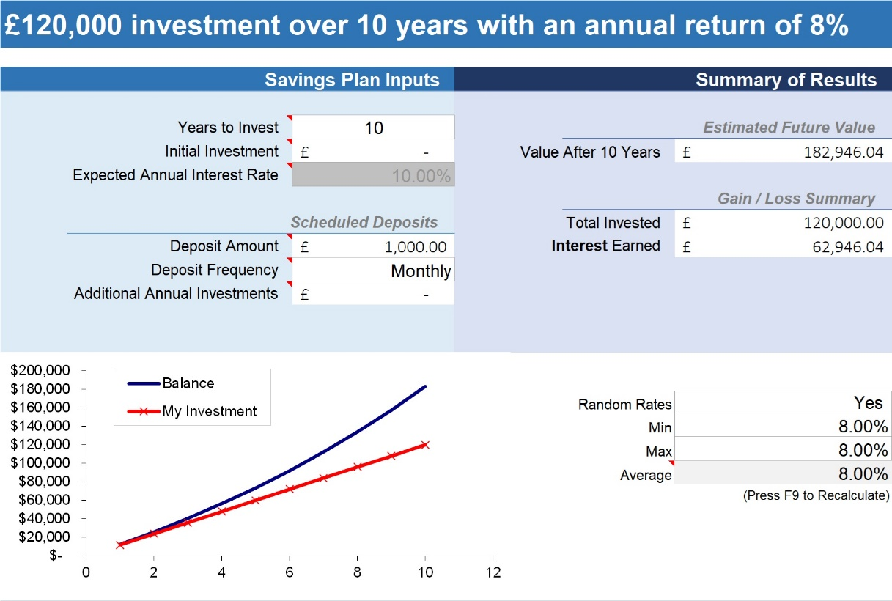
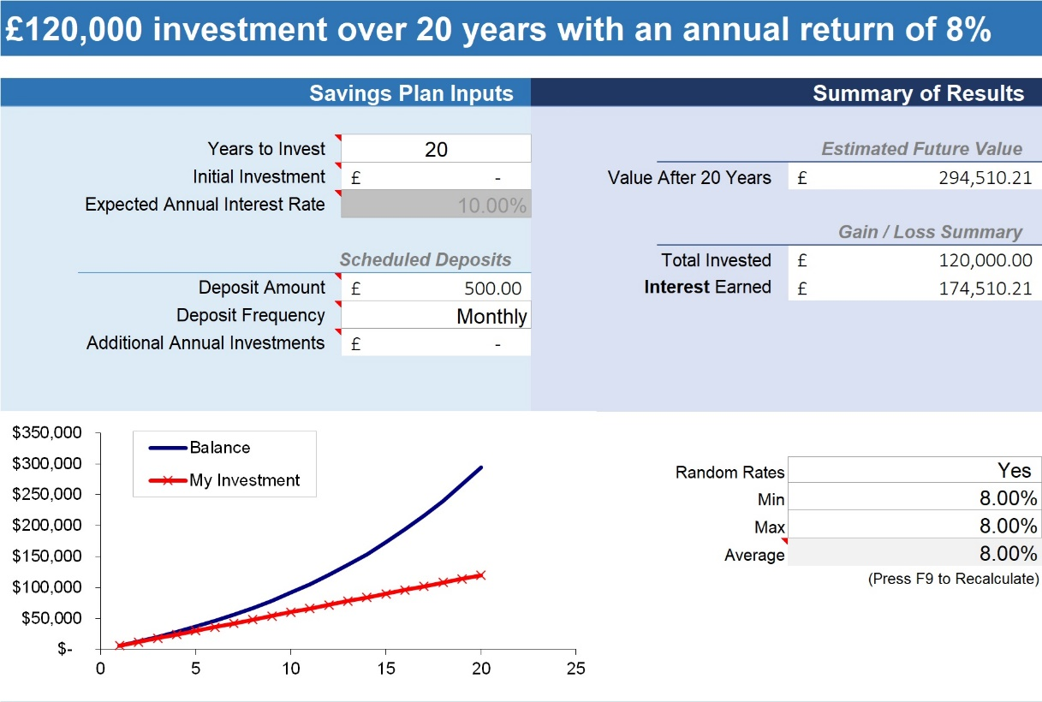
Example: Comparison of Two Savers
10 Years Saving - £120k
20 years saving £120k
10 Years Saving - £87k
20 years saving £87k
£111,564 more as a result of Compound Interest & Time

Slide 19
Key Takeaways
Overpaying your mortgage .
A family-focused budget ensures alignment.
Early saving unlocks compound interest.

Slide 20
Next Steps
Stay consistent and progress.
Set actionable goals.
Review finances and identify areas for improvement.

